Slide 1


Francisco Gaztañaga
2024/02/29

Slide 2

Outline
Executive Summary
Introduction
Methodology
Results
Conclusion
Appendix

Slide 3
Executive Summary
Methodologies used to analyze the data:
Data Collection through API
Data Collection with Web Scraping
Data Wrangling
Exploratory Data Analysis with SQL
Exploratory Data Analysis with Data Visualization
Interactive Visual Analytics with Folium
Machine Learning Prediction
Summary of results
The data was collected from public sources without any inconvenient.
EDA was a great tool for identifying features and predicting the success of lunches. It was also helpful to predict a success launch
Through Machine Learning Prediction it was possible to find the best model to predict successes and failures in rocket launches.

Slide 4
Introduction
The savings in SpaceX launches, compared to its competitors, are found in the reuse of the first stage of the rocket. Therefore, if we can determine whether the first stage will land, we can determine the cost of a launch. This information is required by the company SpaceY in order to compete in the aerospace market. The goal of the project is to create a machine learning pipeline to predict whether the first stage will be successful.
Questions to be answered:
Where is the launch center where most launches were successful?
Which characteristics are the most relevant for a correct prediction of a successful landing?

Slide 5

Section 1

Slide 6
Methodology
Executive Summary
Data collection methodology:
Data from Space X was obtained from 2 sources:
Space X API (https://api.spacexdata.com/v4/rockets/)
WebScraping (https://en.wikipedia.org/wiki/List_of_Falcon/_9/_and_Falcon_Heavy_launches)
Perform data wrangling
Collected data was enriched by creating a landing outcome label based on outcome data after summarizing and analyzing features

Slide 7
Methodology
Executive Summary
Perform exploratory data analysis (EDA) using visualization and SQL
Perform interactive visual analytics using Folium and Plotly Dash
Perform predictive analysis using classification models
Data collected were normalized, dividing in training and test data sets and evaluating them by four different classification models, being the accuracy of each model analyzed using different techniques.

Slide 8
Data Collection
Data collection process involved a combination of API requests from SpaceX REST API (https://api.spacexdata.com/v4/rockets/) and Web Scraping data from a table in SpaceX’s Wikipedia entry (https://en.wikipedia.org/wiki/List_of_Falcon/_9/_and_Falcon_Heavy_launches). We had to use both of these data collection methods in order to get complete information about the launches for a more detailed analysis.

Slide 9
Data Collection – SpaceX API
(Source code)
Steps followed:
Request data from SpaceX API (rocket launch data)
Decode response using .json() and convert to a dataframe using .json_normalize()
Request information about the launches from SpaceX API using custom functions
Create dictionary from the data
Create dataframe from the dictionary
Filter dataframe to contain only Falcon 9 launches
Replace missing values of Payload Mass with calculated .mean()
Export data to csv file

Slide 10
(Source code)
Data Collection – Web Scraping
Steps followed:
Request data (Falcon 9 launch data) from Wikipedia
Create BeautifulSoup object from HTML response
Extract column names from HTML table header
Collect data from parsing HTML tables
Create dictionary from the data
Create dataframe from the dictionary
Export data to csv file

Slide 11
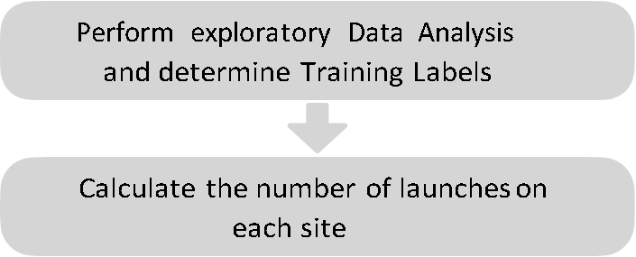
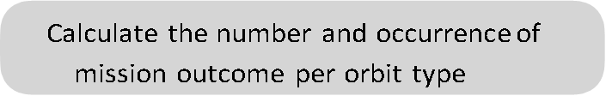


(Source code)
Data Wrangling
The process for data wrangling could be summarized in the flowchart:
Calculate the number and occurrence of each orbit

Slide 12
(Source code)
EDA with Data Visualization
For the Exploratory Data Analysis, were plotted different charts, summarized as follows:
Flight Number vs. Payload (scatter plot)
Flight Number vs. Launch Site (scatter plot)
Payload Mass (kg) vs. Launch Site (scatter plot)
Orbit type vs. Class (bar chart)
Flight number vs. Orbit type (scatter plot)
Payload Mass (kg) vs. Orbit type (scatter plot)
Launch Year vs. Success Rate (line plot)
The objective of those charts was to analyze different pair of variables in order to discover which features are actually related with the success or failure of a mission. Scatter plots were useful for a first sight analysis about relationship between variables. Bar charts show relationships measured values from different categories.

Slide 13
(Source code)
EDA with SQL
Queries performed in order to display:
Names of unique launch sites
5 records where launch site begins with ‘CCA’
Total payload mass carried by boosters launched by NASA (CRS)
Average payload mass carried by booster version F9 v1.1.
The total number of successful and failed mission outcomes
The failed landing outcomes in drone ship, their booster version and launch site names.

Slide 14
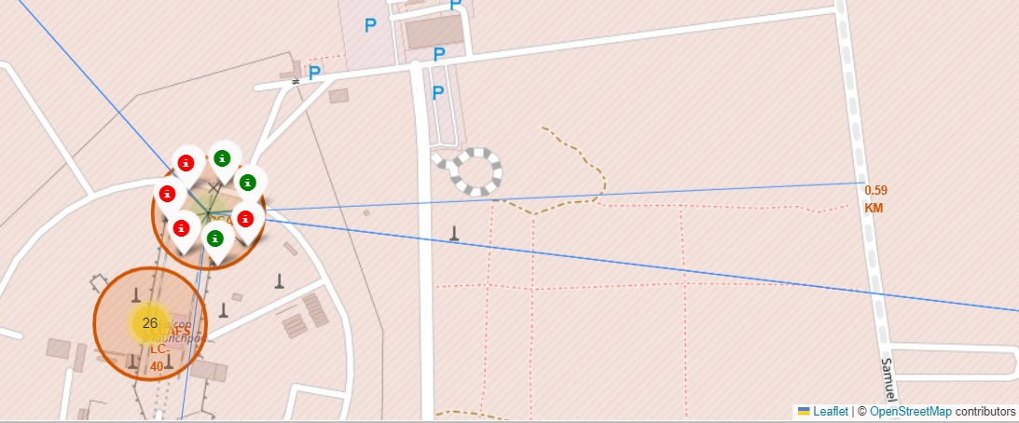
(Source code)
Build an Interactive Map with Folium
There were added to the interactive map: labeled circles in launch sites, colored markers for successful (green) and unsuccessful (red) lunches, and lines, labeled with the length of it, indicating distances between different places and launch sites. This way, it is easier to analyze where the most of successful launches occurred.

Slide 15
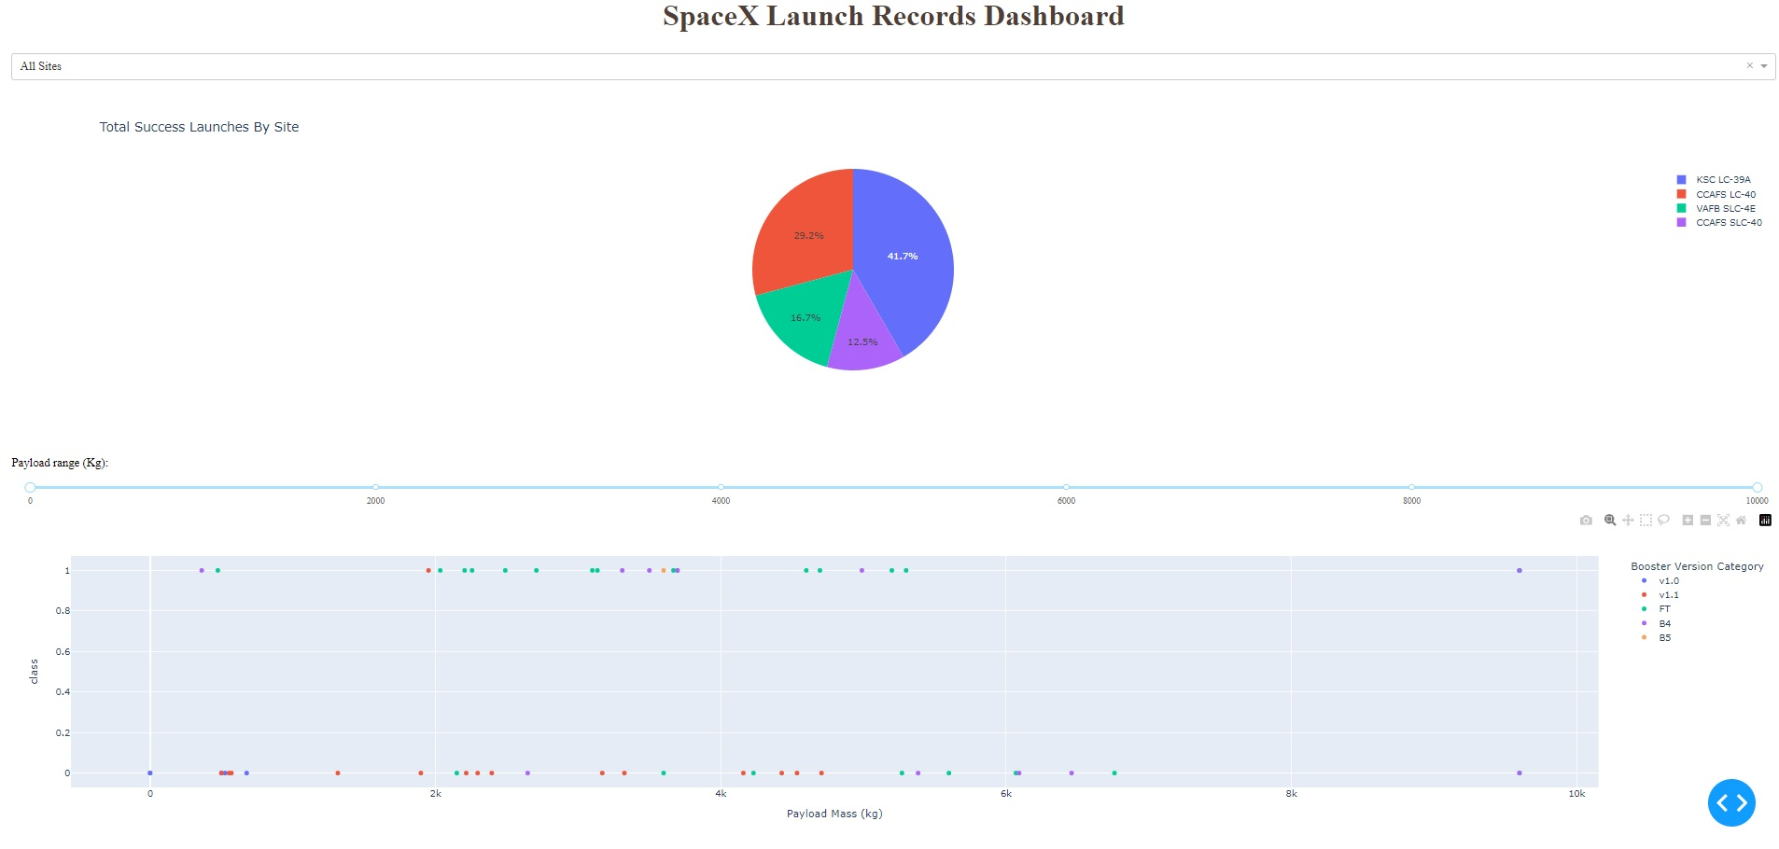
(Source code)
Build a Dashboard with Plotly Dash
There were made:
Dropdown List with Launch Sites
Allow user to select all launch sites or a certain launch site
Pie Chart Showing Successful Launches
Allow user to see successful and failed launches as a percent of the total
Slider of Payload Mass Range
Allow user to select payload mass range
Scatter Chart Showing Payload Mass vs. Success Rate by Booster Version
Allow user to see the correlation between Payload and Launch Success

Slide 16
(Source code)
Predictive Analysis (Classification)
The tools used were:
Create NumPy array from the Class column
Standardize the data with StandardScaler. Fit and transform the data.
Split the data using train_test_split()
Create a GridSearchCV object with cv=10 for parameter optimization
Apply GridSearchCV on different algorithms: Logistic Regression (LogisticRegression()), Support Vector Machine (SVC()), Decision Tree (DecisionTreeClassifier()), K-Nearest Neighbor (KNeighborsClassifier())
Calculate accuracy on the test data using .score() for all models
Assess the confusion matrix for all models
Identify the best model using Jaccard_Score, F1_Score and Accuracy

Slide 17
Results summary
Exploratory Data Analysis
Launch success has improved over time.
KSC LC-39A has the highest success rate among landing sites.
Orbits ES-L1, GEO, HEO and SSO have a 100% success rate.
Visual Analytics
Most launch sites are near the equator, and all are close to the coast
Launch sites are far enough away from anything can be damaged in a fail launch (city, highway, railway), while are still close enough to bring people and material to support launch activities.
Predictive Analytics
Decision Tree model is the best predictive model for the dataset with a test accuracy of 0.94.

Slide 18

Section 2

Slide 19
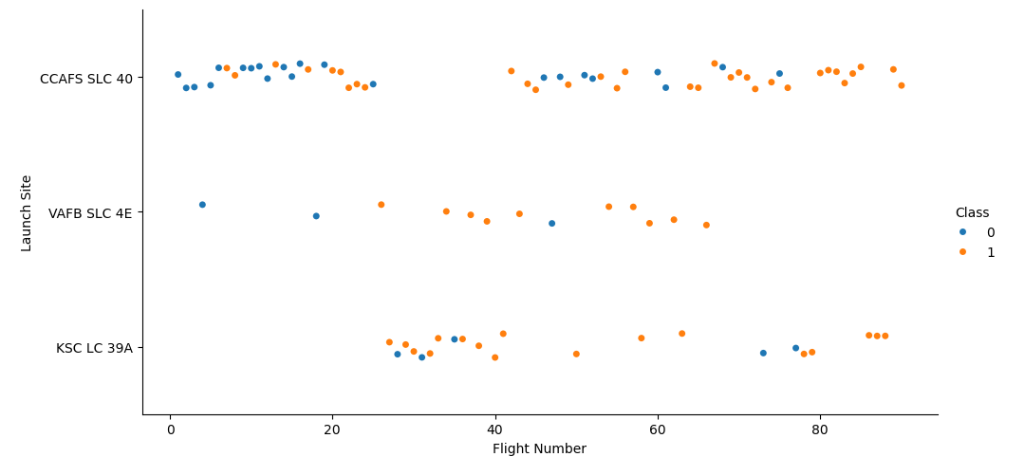
Flight Number vs. Launch Site
It can be seen that:
Higher flight number is related with more successful (class = 1)
Around half of launches were from CCAFS SLC 40 launch site
VAFB SLC 4E and KSC LC 39A have higher success rates

Slide 20
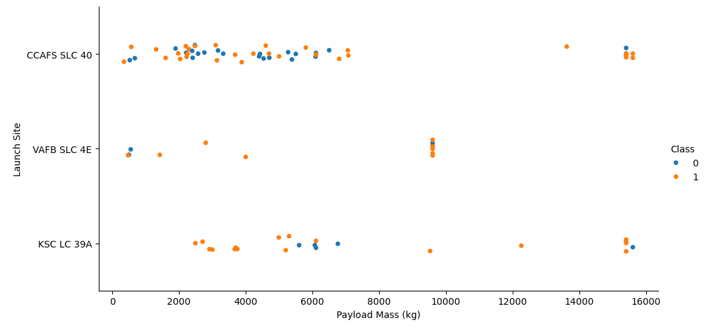
Payload vs. Launch Site
Typically, the higher the payload mass (kg), the higher the success rate
Most launces with a payload greater than 7,000 kg were successful
KSC LC 39A has a 100% success rate for launches less than 5,500 kg
VAFB SKC 4E has not launched anything greater than ~10,000 kg

Slide 21
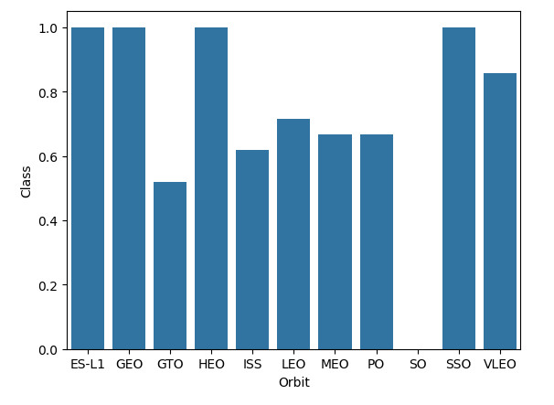
Success Rate (Class) vs. Orbit Type
Understanding the class (1 to 0) as the succession rate percentage over 100, it can be seen:
100% Success Rate: ES-L1, GEO, HEO and SSO
50%-80% Success Rate: GTO, ISS, LEO, MEO, PO
0% Success Rate: SO

Slide 22
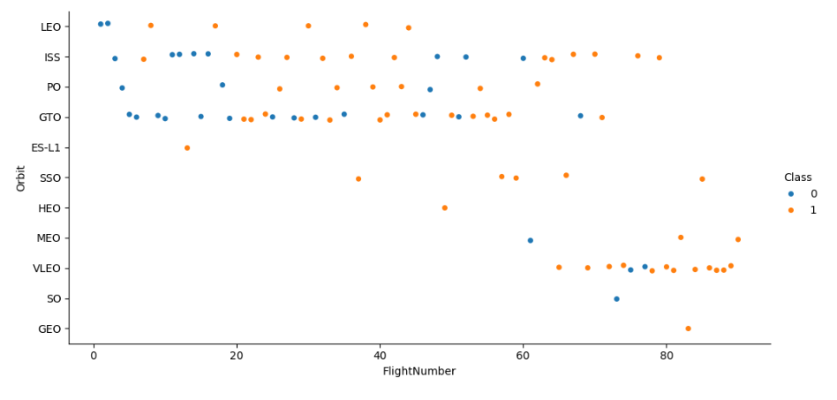
Flight Number vs. Orbit Type
The success rate usually increases with the number of flights for each orbit
There are orbits highly related with flight number: HEO, MEO, VLEO, SO and GEO orbits were studied later the first 50 flights
Last flight numbers are mor successful than first ones.

Slide 23
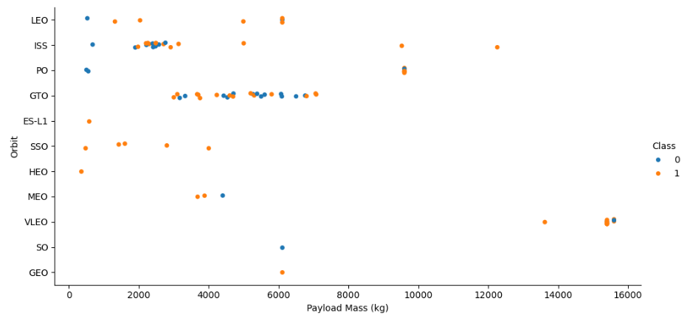
Payload vs. Orbit Type
Heavy payloads worked better with LEO, ISS and PO orbits
The GTO orbit has mixed success with medium payloads
Some orbits were studied with a narrow set of Payload mass while others were analyzed with a wider range of values.

Slide 24
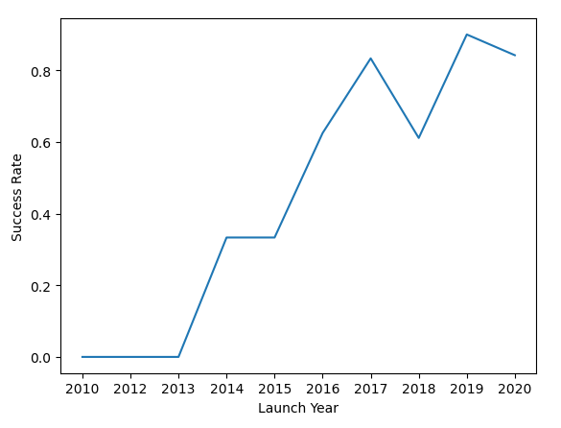
Launch Success Yearly Trend
It can be observed that, through the years, succession rate increased steadly.
In the first 3 years not even one of the launches was successful

Slide 25
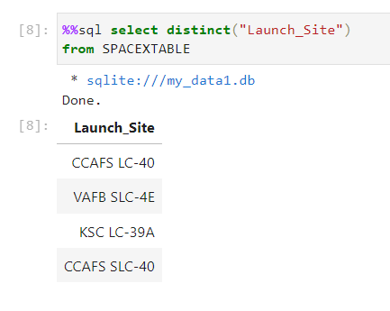
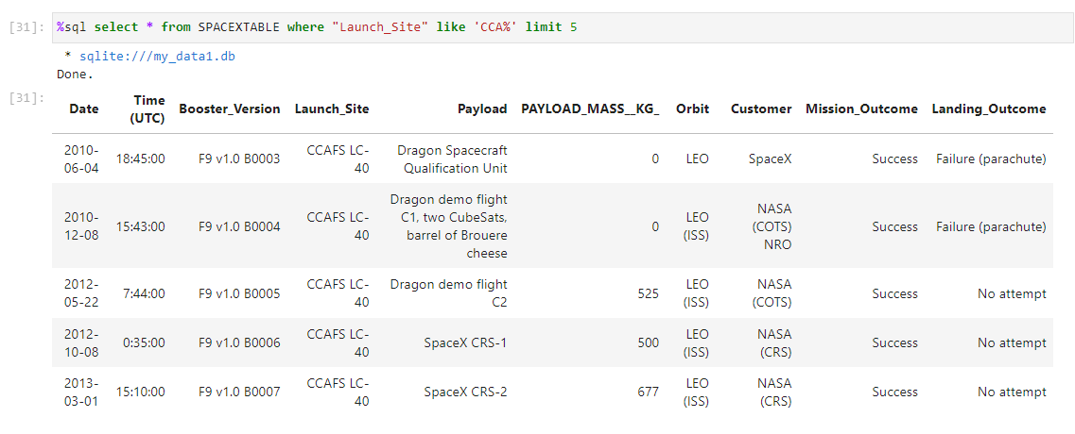
All Launch Site Names and starting with ‘CCA’
On the left, a query to show the 4 different Launch sites.
On the Right, it show the query to access to Records with Launch sites starting with ‘CCA’.

Slide 26
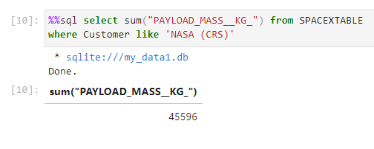
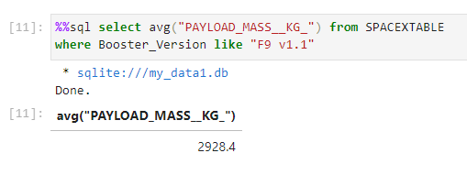
Payload Mass
On the left, it is shown the calculation of the total payload carried by boosters from NASA and the query to access to it.
On the right, the average payload mass carried by booster version F9 v1.1 is presented with its corresponding query.

Slide 27
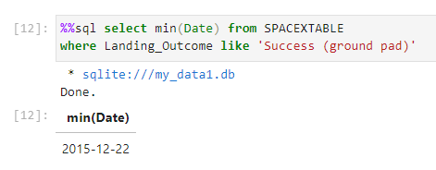
First Successful Ground Landing Date
With this query it is possible to see the date of the first successful landing outcome on ground pad: the 22th of December 2015,

Slide 28
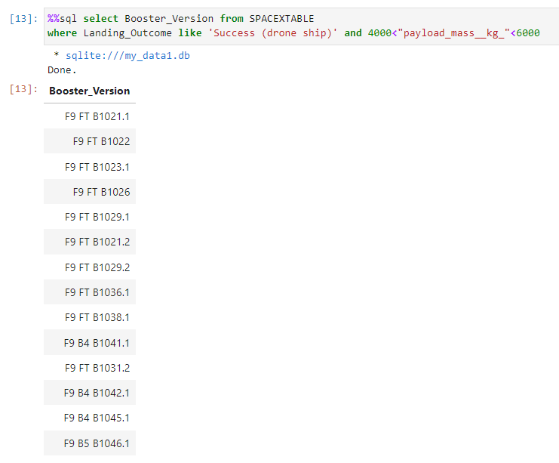
Successful Drone Ship Landing with Payload between 4000 kg and 6000 kg
This query shows a list of names of boosters which have successfully landed on drone ship and had payload mass greater than 4000 kg but less than 6000 kg.

Slide 29
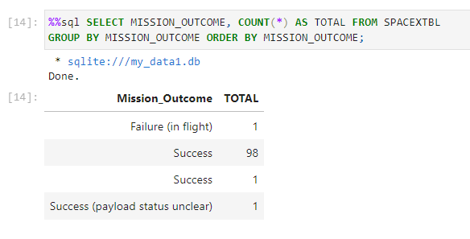
Total Number of Successful and Failed Mission Outcomes
It is shown how to calculate the total number of successful and failed mission outcomes.
The result is:
100 successes
1 failures

Slide 30
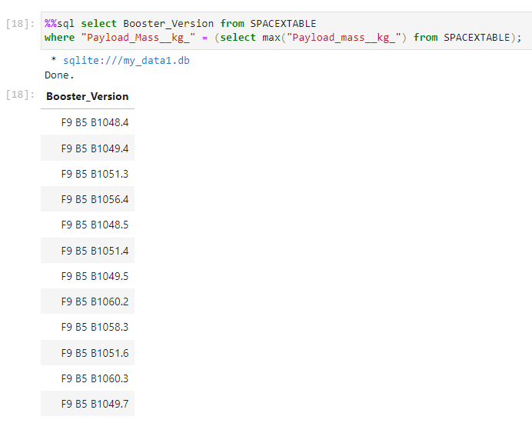
Boosters Carried Maximum Payload
Here, the query to list the names of the booster which have carried the maximum payload mass.

Slide 31
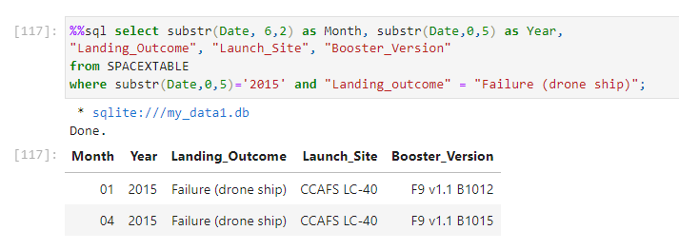
2015 Launch Records
Here, the query to list the failed landing outcomes in drone ship, their booster versions, and launch site names for in year 2015.

Slide 32
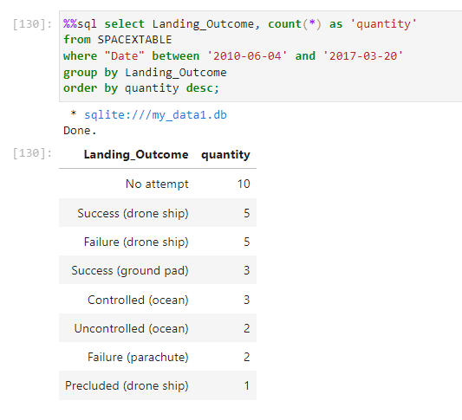
Rank Landing Outcomes Between 2010-06-04 and 2017-03-20
With this query it is ranked the count of landing outcomes between the date 2010-06-04 and 2017-03-20, in descending order.

Slide 33

Section 3

Slide 34
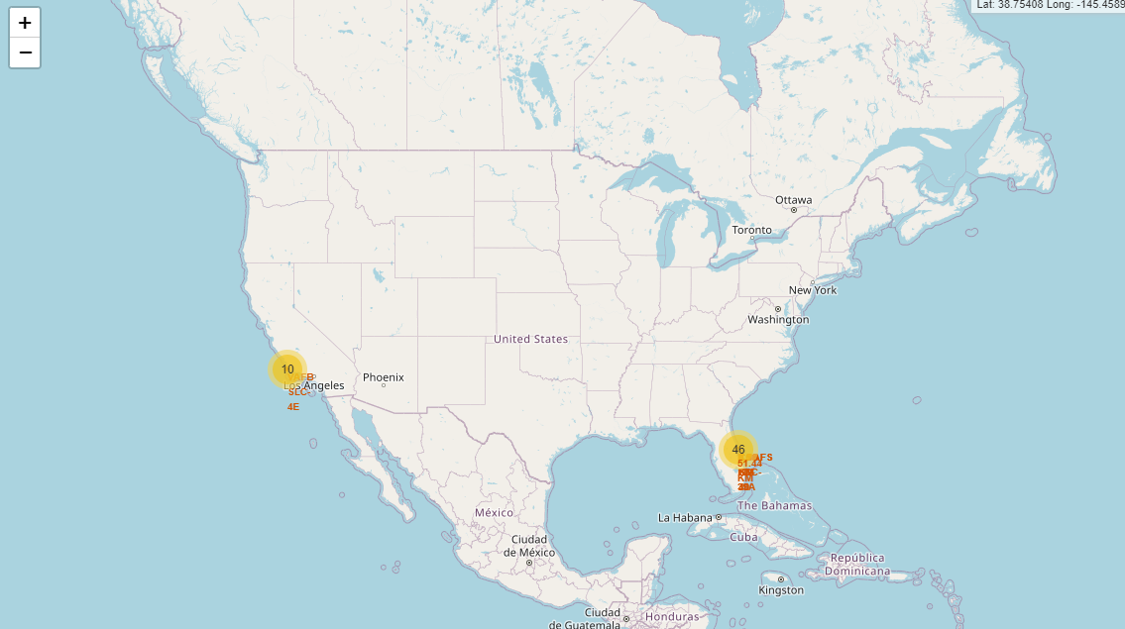
Launch Sites
It can be seen the largest number of launches were carried out in the East coast, in Florida, while in California, only 10 launches took place. All of them, in de USA.

Slide 35
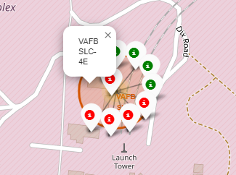
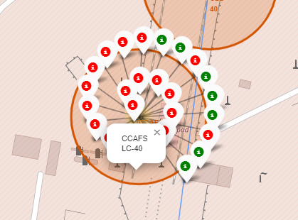
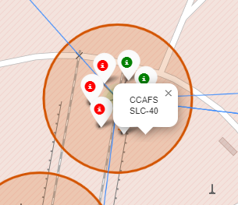
Color-labeled launch outcomes
Here it is possible to see 3 different locations, with its own name labels and a marker for each successful (green) and failed (red) launch.
The one on the left, represents the location placed in California. The other two, are located in Florida.

Slide 36
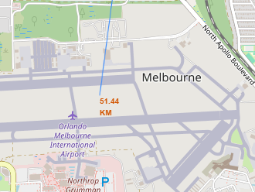
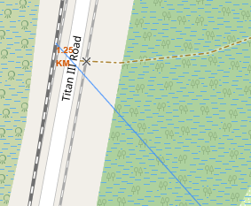
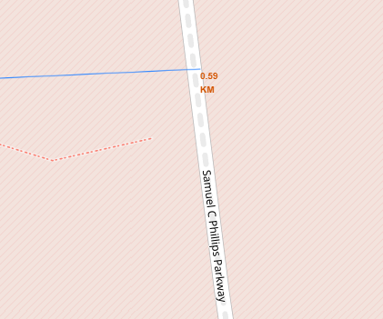
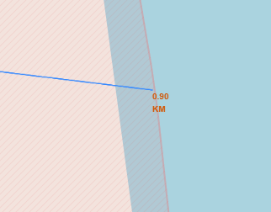
Distances from CCAFS SLC-40
It is shown screenshots of some selected places -(1) a railway, (2) a pathway, (3) a coastline, and (4) Melbourne- and its respective distances to the launch site CCAFS SLC-40.
(1) (3) (4) (5)

Slide 37

Section 4

Slide 38
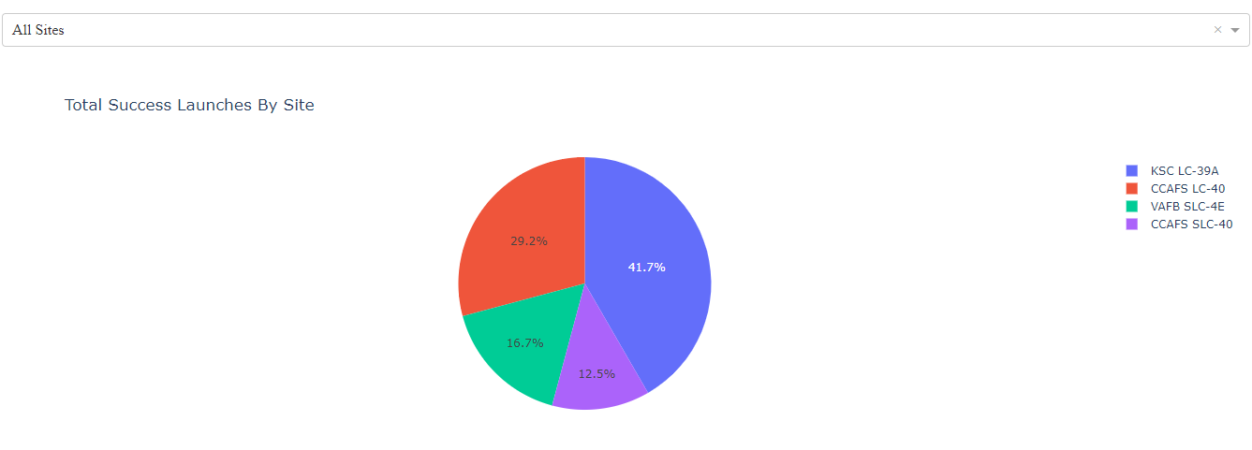
Launch Success by Site
It can be seen a comparative of the success rate of the 4 different Launch Sites.
It is observed that KSC LC-39A has the highest amount of success (41.7% of the total launches)

Slide 39
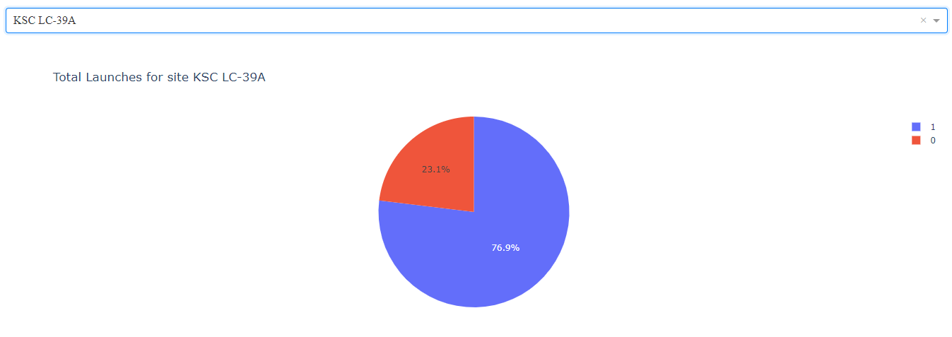
Launch Success of KSC LC-39A
Exploring all launches occurred in KSC LC-39A, it is observed that 76.9 % of launches were successful, while 23.1 % were unsuccessful.

Slide 40
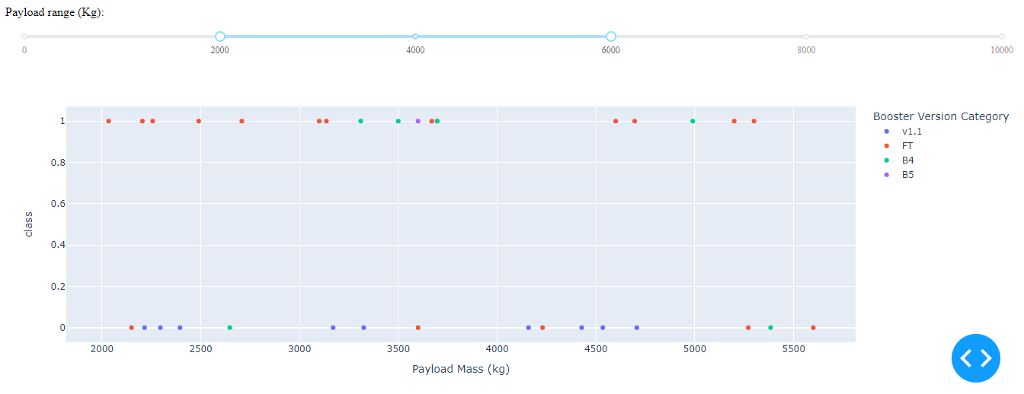
Payload Mass and Success
It can be seen successes (class 1) and failures (class 0), for all Launch sites, colored according to different booster versions. The slider above allows you to select different payload mass ranges.
For example, if we select payload mass in 2000 kg to 6000 kg range, FT booster version has the highest number of success launches, as it is shown below.

Slide 41

Section 5

Slide 42
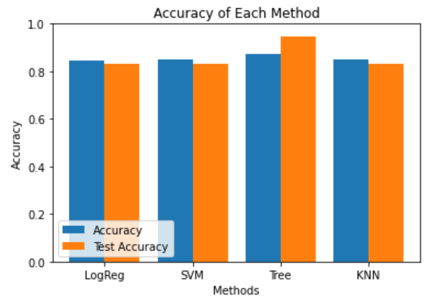
Classification Accuracy
There were compared 4 models: Logistic Regression, Support Vector Machine, Decision Tree Classifier, and K-nearest Neighbors.
Decision Tree Classifier showed the highest train accuracy (R² =0.8889) and test accuracy (R² = 0.9444).

Slide 43
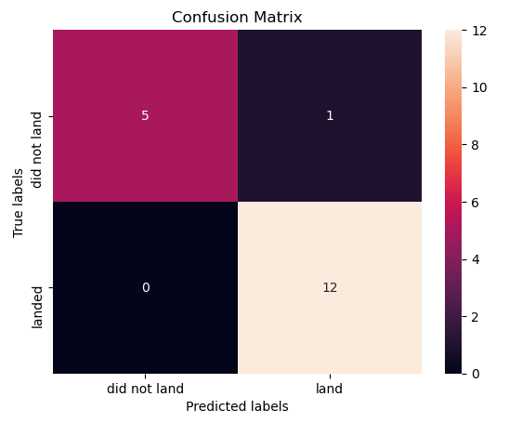
Confusion Matrix
The confusion matrix for the Classification Tree model is shown to the right.
It can be seen that the model classified almost correctly landed and not landed cases, but it failed just in the classification of one not landed case as a landed.

Slide 44
General Conclusions
The best launch site is KSC LC-39A;
Launches above 9,000kg trend to be more successful;
Launch success rate starts to increase in 2013 with a steady growth.
Orbits ES-L1, GEO, HEO, SSO, VLEO have the highest success rate.
KSC LC-39A have the most successful launches of any sites.
Decision Tree Classifier can be used to predict successful landings and increase profits.

Slide 45
Appendix
The complete work, Jupyter Notebooks and Python codes can be found in the link https://github.com/FranGazta/Data-Science-Capstone-Coursera

Slide 46


